Slide 1






HOSPITAL NETWORK DESIGN

Slide 2


TABLE OF CONTENTS
SNO. | TITLE
1 | ABSTRACT
2 | NETWORK REQUIREMENTS
3 | HOSPITAL SEGMENTS
4 | FEATURES AND SERVICES
5 | COST OF NETWORK
6 | CONFIGURATION
7 | DEFINITIONS
8 | NETWORK DIAGRAMS
9 | CONCLUSION

Slide 3
ABSTRACT
This report describes the network design of Health care management or Hospital. In this network topology the nodes (i.e., computers, switches, routers or other devices) are connected to a local area network (LAN) and network via links (twisted pair copper wire cable or optical fiber cable). We have used Cisco Packet Tracer for designing the network topology It’s a general design which can be implemented at any higher level to manage network system.

Slide 4
NETWORK REQUIREMENTS
In Health care Network topology, we have desktop Computer, laptops, smart phone. There is a data flow between the devices within the system. We have divided our network into segments like for Hospital wards, clinical area etc. We have also used SSH for security. Our network requirements includenetwork devices like routers, switches, server.

Slide 5
HOSPITAL SEGMENTS
- General ward
- Private ward
-Clinical Area
- IT Department
- Entrance Reception
-Lobby and Parking

Slide 6
FEATURES AND SERVICES
•DHCP
•DNS
•Subnetting
•HTTPS
•SSH
•SMTP
•FTP
•WIFI

Slide 7
COST OF NETWORK
-Cisco Switch
250$ Each, 1250$ Cost of 5 Switch
-Cisco Router
350$ Each, 2100$ Cost of 6 Router
-Cisco Server
400$ Each, 800$ Cost of 2 Server
-Computer Cost
125$ Each, 1500$ Cost of 12 Computer
Total Cost = 5650$

Slide 8
CONFIGURATION
The diagram is properly commented.We have divided the diagram into 6 segments as named above. Hospital Segments representing different departments of hospital. Followingare the running configuration of routers and switches relatedto different segmentsof hospital respectively:
General Ward Switch General Ward Router
Private WardSwitch Private WardRouter
Clinical Area Switch Clinical Area Router
IT Department Switch IT Department Router
Entrance Switch Entrance Router

Slide 9
DEFINITIONS
DHCP : The Dynamic Host Configuration Protocol(DHCP) is a network management protocol used on UDP/IP networks whereby a DHCP server dynamically assignsan IP address and other network configuration parameters to each device on a network so they can communicate with other IP networks.
DNS : The Domain Name System is a hierarchical and decentralized naming system for computers, services, or other resources connected to the Internet or a privatenetwork.
SUBNETTING : A subnetwork or subnet is a logical subdivision of an IP network. The practice of dividing a network into two or more networksis called subnetting.
HTTPS : Hypertext Transfer ProtocolSecure is an extension of the HypertextTransfer Protocol. It is used for secure communication over a computernetwork and is widely used on the Internet. Hypertext Transfer Protocol Secure is an extension of the HypertextTransfer Protocol. It is used for secure communication over a computernetwork and is widely used on the Internet.

Slide 10
SSH : Secure Shell is a cryptographic network protocol for operating networkservices securely over an unsecured network.
SMTP : The Simple Mail Transfer Protocolis a communication protocol for electronic mail transmission.
FTP : The File TransferProtocol is a standard networkprotocol used for the transfer of computer files between a client and server on a computernetwork.
WI-FI : Wi-Fi is the name of a wireless networking technology that uses radio waves to providewireless high-speed Internet and network connections.

Slide 11
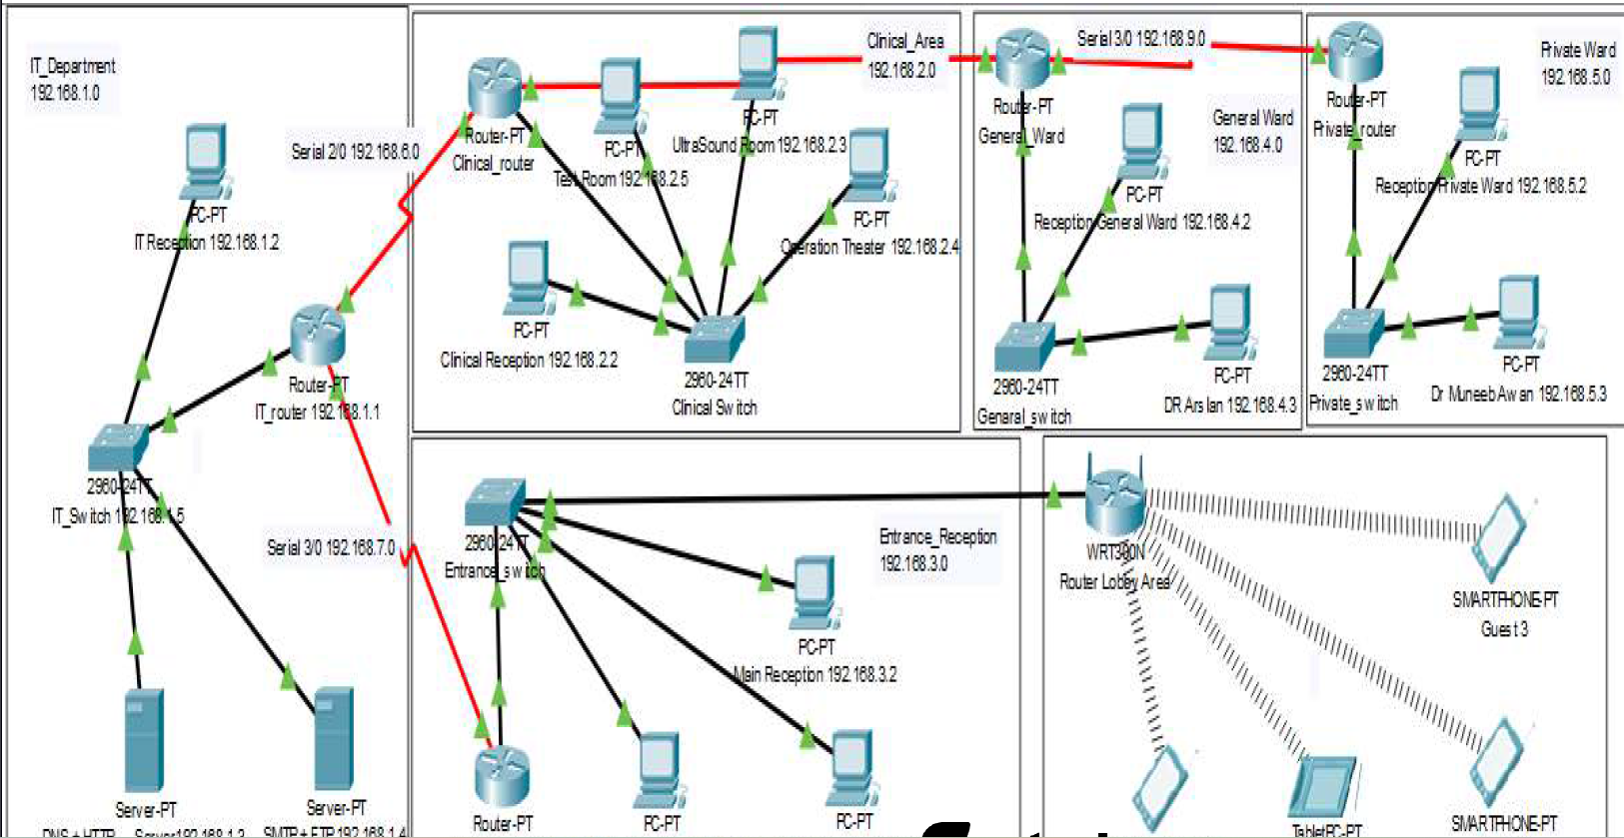
NETWORK DIAGRAM

Slide 12
CONCLUSION
This report describeshow we have designed networktopology of hospital (Health care Management System). With VLSM for Subnetting, segmented the diagram into 5 segments.This topology can also be implemented on higher level of hospitals.

Slide 13

TEAM MEMBERS
OM SINGH TONGAR
EKTA KALRA
TUSHAR TANISHQ
SACHIN GUPTA
DEBMALYA SANTRA

Slide 14

Thank You

